Slide 1
Target Marketing
On
Banking Product
Presented By:-
Jitendra Patel

Slide 2
Objective
Build a predictive model which can be used to target banking customers for a newly introduced Banking Product.
Product:- “Annuity”

Slide 3
Data Description
Dataset : Banking data
Source of Data: bigML
48 variables like Age of Oldest Account, Checking Balance, Amount Deposited, Direct Deposit , Number Insufficient Fund
32000 Observations

Slide 4
Goals :
To improve the performance of model and increase the classification accuracy using various approaches.
To improve class Recall as our focus is to predict the one’s who are interested in buying the product.

Slide 5
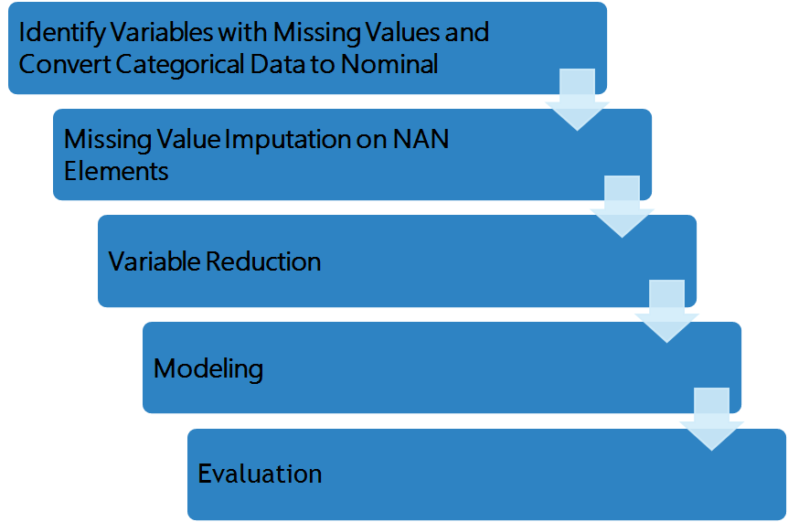
Implementation Flow

Slide 6
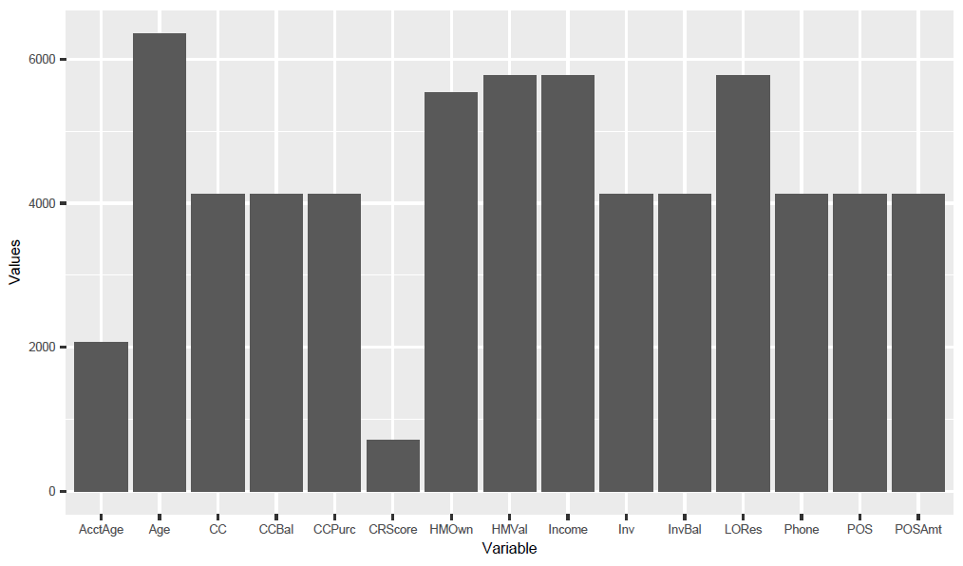
Step 1 : Identification of Variables with Missing Values

Slide 7
Step 2 : Handling of Missing values
Imputed missing values using Median
Mean is sensitive to outliers
Regression was not very feasible as target variable was dichotomous
After missing value imputation we converted 2 categorical variables into nominal
Finally, we normalized the data using z-transformation

Slide 8
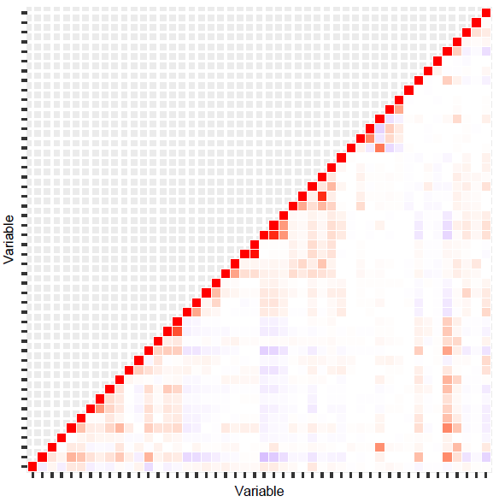
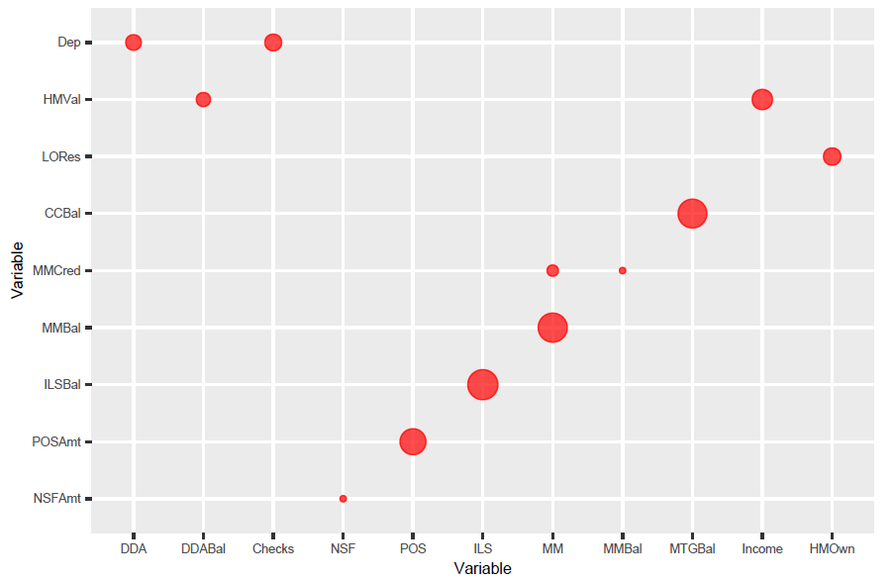
Step 3 : Variable Reduction

Slide 9
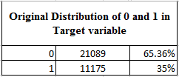

Split Data
Split Data Using Random Sampling

Slide 10
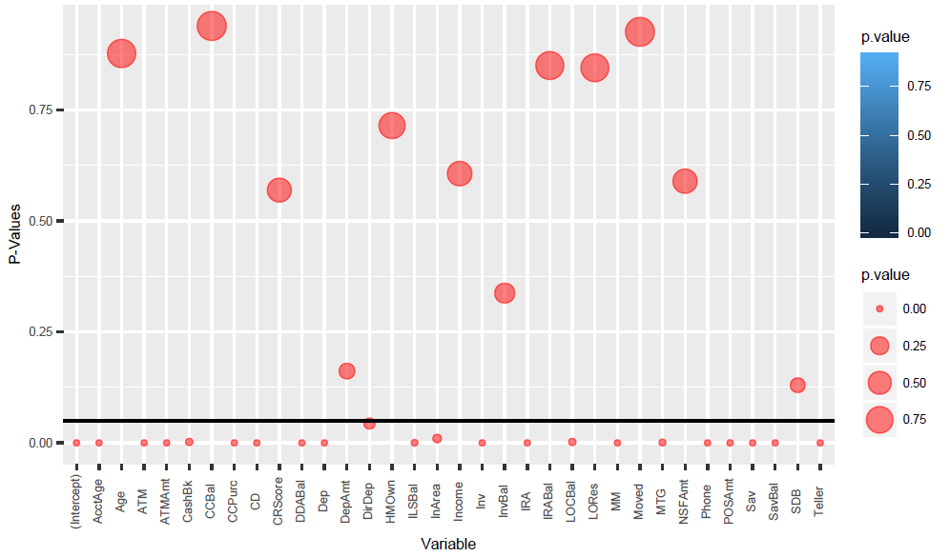
Fitted Logistic Regression to find significant variables

Slide 11
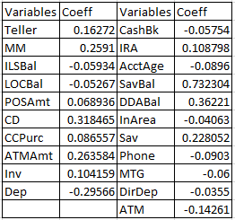
Explanatory Model after Variable Reduction

Slide 12
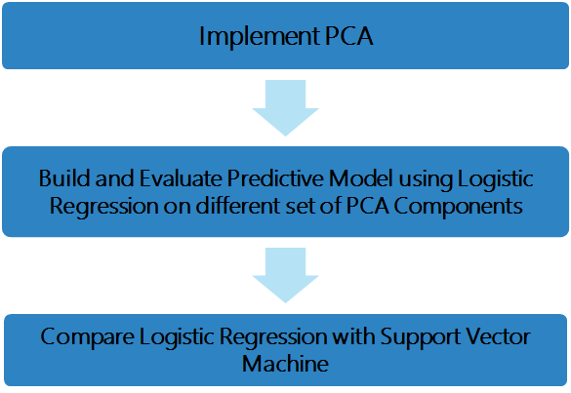
Step 4 : Modeling & Evaluation

Slide 13
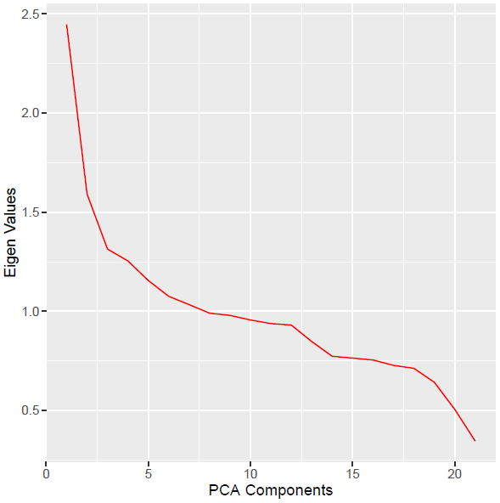
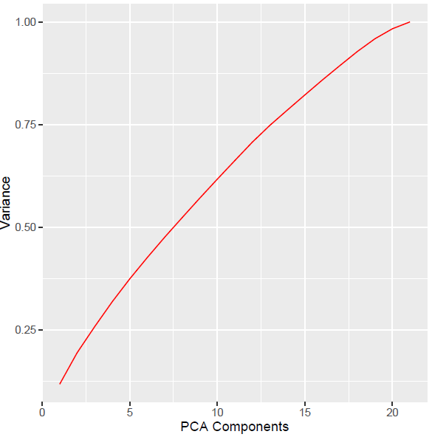
Principle Component Analysis

Slide 14
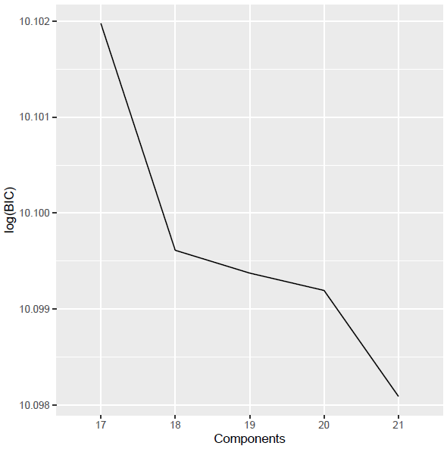
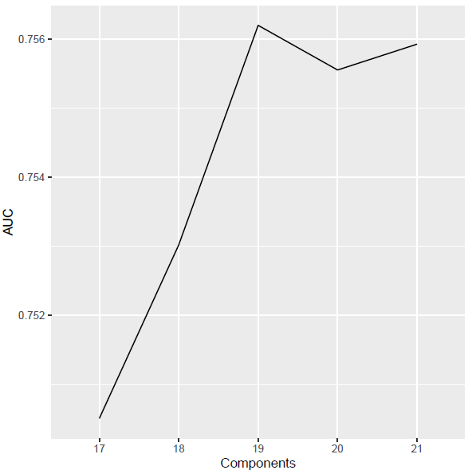
Model Evaluation

Slide 15
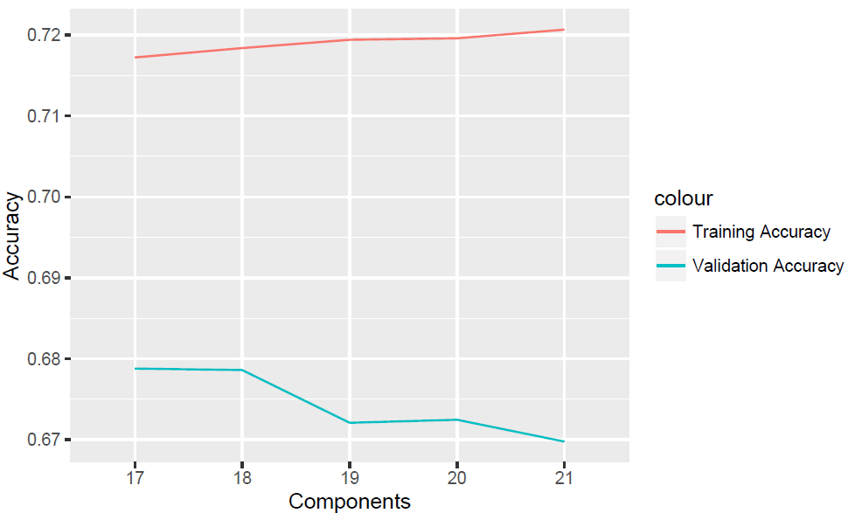
Training & Testing Accuracy

Slide 16
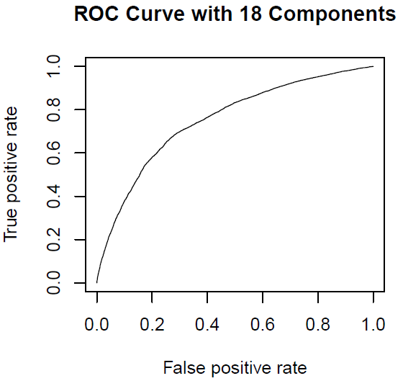
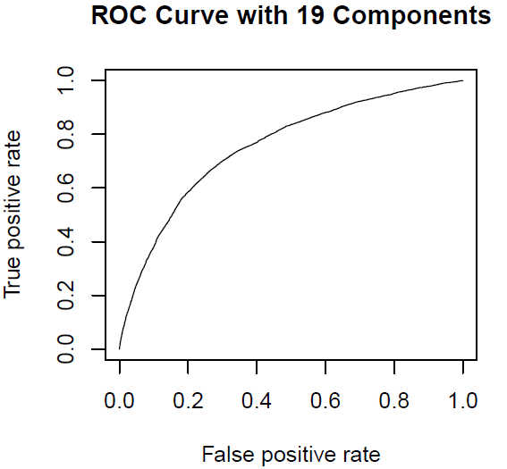


ROC Curve & Confusion Matrix of Best Models

Slide 17
Comparison of Accuracy Between Logistic Regression and SVM
LOGISTIC REGRESSION ACCURACY = 67.86%
SVM ACCURACY = 59.23%

Slide 18


